Slide 1
RTT Based Indoor Positioning
Vijay Anandan

Slide 2
Requirements
Wi-Fi 802.11mc capable chipset: This is the most important requirement for Wi-Fi RTT. The device must have a chipset that supports the Wi-Fi 802.11mc protocol in order to use RTT. Most modern smartphones and tablets have this capability, but older devices may not.
Antenna Arrays: Wi-Fi RTT uses multiple antennas in order to triangulate the position of the device. Therefore, devices with multiple antennas are necessary for Wi-Fi RTT to work accurately.
Location Services: Wi-Fi RTT requires access to the device's location services in order to provide accurate positioning. This means that the device must have location services enabled and allow the app or service using Wi-Fi RTT to access its location data.
Software Support: In addition to hardware requirements, Wi-Fi RTT also requires software support. This means that the device's operating system and applications must support Wi-Fi RTT in order for it to work.[ Above Android API 9]
Overall, Wi-Fi RTT requires a modern device with a Wi-Fi 802.11mc capable chipset, multiple antennas, location services enabled, and software support.

Slide 3
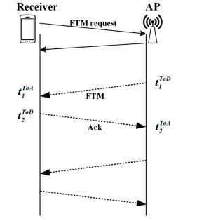
RTT ?
RTT stands for "Round-Trip Time" and refers to the time taken for a wireless signal to travel from a mobile device to a receiver and back again.
In indoor positioning, RTT is used to determine the distance between a mobile device and a set of access points.
Wi-Fi RTT and the related Fine-Time-Measurement (FTM) capabilities are specified by the IEEE 802.11-2016 standard. Wi-Fi RTT requires the precise time measurement provided by FTM because it calculates the distance between two devices by measuring the time a packet takes to make a round trip between the devices and multiplying that time by the speed of light.

Slide 4


RTT Calculation
The RTT formula is used to calculate the flight time of a wireless signal based on Time of Arrival (ToA) and Time of Departure (ToD) measurements.
The flight time of the signal can be used to estimate the distance between a mobile device and an access point or beacon.
The speed of light is used in the distance estimation formula, which is d = c * 𝑻𝒐𝑭 / 2, where d is the distance, c is the speed of light, and 𝑻𝒐𝑭 is the flight time of the signal.

Slide 5
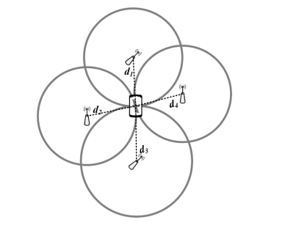
Localization using Least square
“d” - will be calculate from the RTT based on the previous slides
By know access point information and using Least square (LS) kind of classic positioning algorithm for multilateration will help us in locating the coordinates

Slide 6
Accuracy

